Slide 1

Introduction to Web Programming

Slide 2
WTH are We Doing Here?
Quick insight into Introduction to Web Programming
Notes:
The goal is to help you view the web from a Developer’s perspective and understand the inner workings an online application.

Slide 3
The Goal:
STOP seeing the web as just a USER
and START seeing it as a DEVELOPER

Slide 4
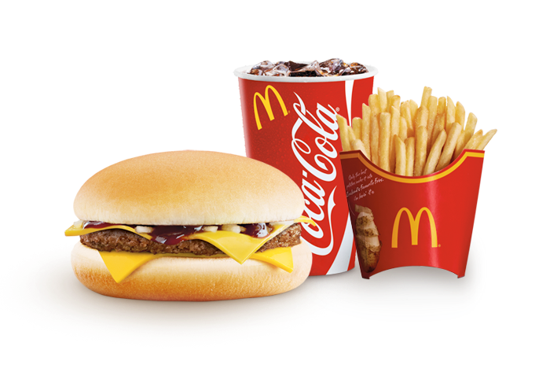
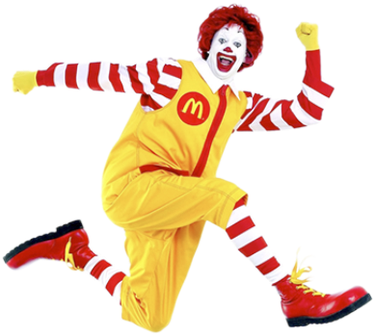
User VS Developer
USER
DEVELOPER
Notes:
User enjoys a delicious meal at McDonalds.
The developer designs and creates the meal that the user gets to enjoy.

Slide 5
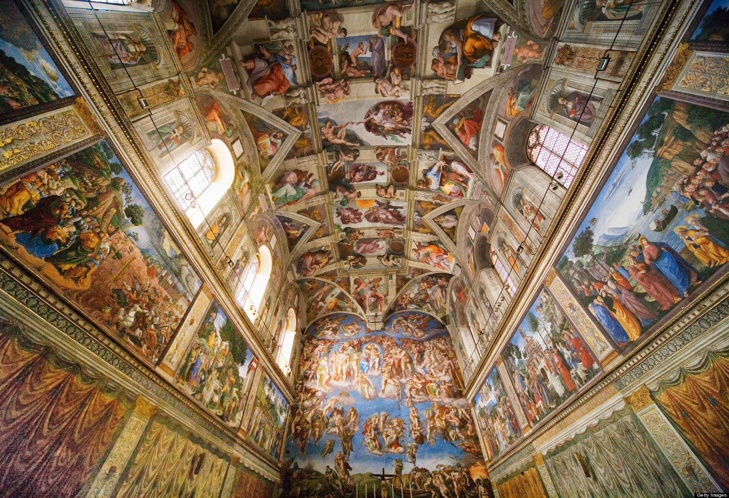
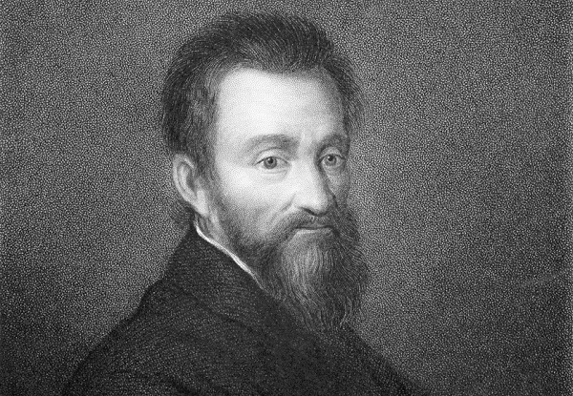

User VS Developer
USER
DEVELOPER
Notes:
The ceiling of the Sistine Chapel is enjoyed by millions of tourists every year.
The painter/developer was, of course, the famous Michelangelo. Not a ninja Turtle.

Slide 6
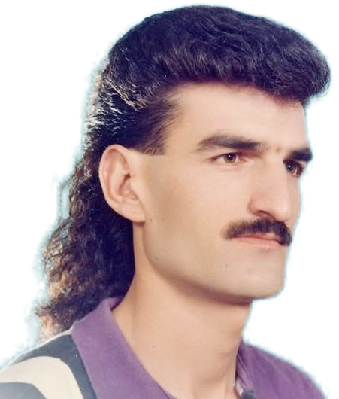
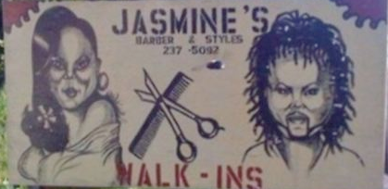
User VS Developer
USER
DEVELOPER
Notes:
The user looks stylish for his all occasion hair style; the mullet.
The developer designs, cuts, and styles his locks.

Slide 7
User VS Developer

Slide 8
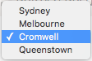
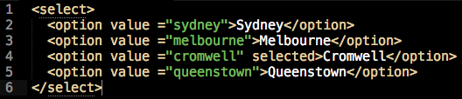
User VS Developer
HOW:
User sees a list of options:
Developer sees a list of options:
Notes:
End User (how most of the web is viewed) sees the 4 options consisting of Australian cities.
Developer sees the options as an HTML Select Tag with populated options, possibly from a database, API, or an array if it’s dynamic.

Slide 9

User VS Developer
HOW:
User sees a header:
Developer sees a header:
Notes:
End User (how most of the web is viewed) sees the colourful Google Canada logo as you see above.
Developer sees the header as a DIV tag

Slide 10
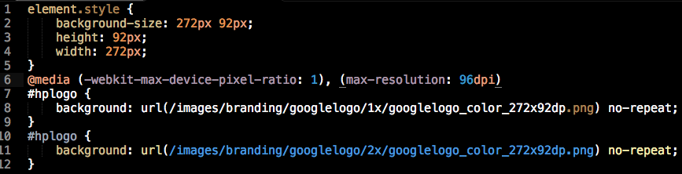
User VS Developer
HOW:
Developer sees a header:
Developer sees a header:
Notes:
Developer sees the header as CSS (styles) and the Developer sees the header as an JavaScript event.

Slide 11

User VS Developer
HOW:
User sees an image gallery:
Notes:
End User (how most of the web is viewed) sees all the great images and interactive features.

Slide 12


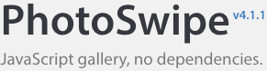


User VS Developer
HOW:
Developer sees an image gallery:
Notes:
Developer sees HTML, CSS, a JavaScript Library, and a database connection to store the URLs of the images which are stored on Amazon S3.

Slide 13
Why Web Development
A Quick Group Activity
In groups of 3, establish 5 reasons to choose web based applications over traditional software?
Notes:
https://37signals.com/webbased

Slide 14
How the Web Works?
A Super Simple Overview of Web Page Communication
Notes:
A very brief and oversimplified explanation of Internet Communication

Slide 15
A Static Web Site
Notes:
Static web sites differ from Dynamic web sites in that they simply render a requested file without the need of running a script.

Slide 16






Notes:
user uses client to request a web site
the request is sent to the server that hosts the web site through a series of routers and exchanges
The server evaluates the extension of the requested file
If the file requested isn’t a script, then it will retrieve the file
The file is returned as HTML and then rendered by the user’s client

Slide 17
A Dynamic Web Site

Slide 18









Notes:
user uses client to request a web site
the request is sent to the server that hosts the web site through a series of routers and exchanges
The server evaluates the extension of the requested file (*.html, *.php, *.py, *.asp, *.rb, etc…)
If a script is requested, the script will run
It could access the file system
It could access the database
It could access a mail server
The response is rendered into HTML and returned to the users client

Slide 19
STATIC | DYNAMIC
data/content is entered directly into the HTML page | data/content is pulled from a database, API, or filesystem
everyone receives the same data/content | data/content can be customized for the user
data/content mutation can be performed only with client side scripting and therefore circumvented | data/content mutation can be performed with server side scripting and therefore is guarded
user input is sanitized by client side validation which isn’t secure | user input is sanitized by server side validation which is secure

Slide 20
What is data?
A look at data Breaking down a web apps data system

Slide 21

FACEBOOK
Broken down…
Notes:
What data does Facebook store?
posts
profiles
photos
likes
videos
advertisements
groups
messages
applications

Slide 22

Amazon
Broken down…
Notes:
What data does Amazon store?
profiles
stores
shipping info
products
reviews
images
orders
history

Slide 23
A thorough example…
A look at dynamic data A Rich Example

Slide 24
“A web application is a lot like a pub.”
– Rich Freeman

Slide 25

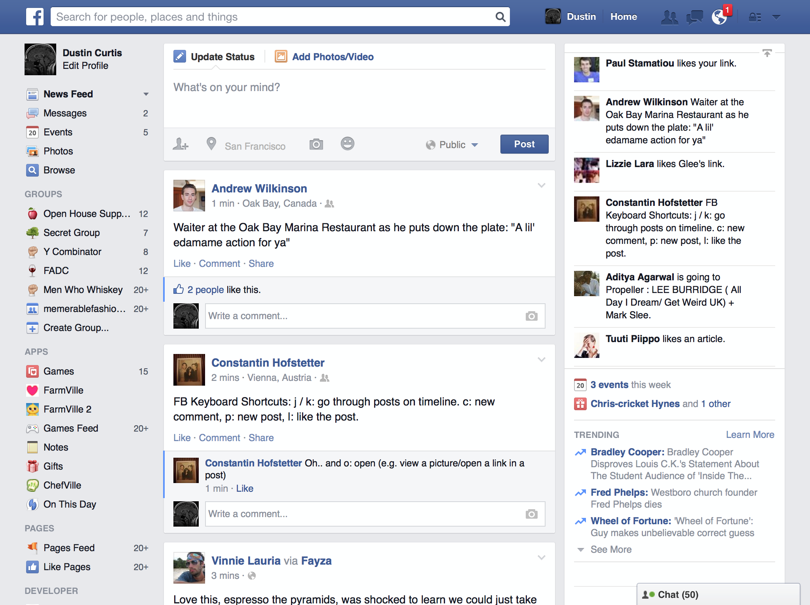


“Both have something people want to see or use.”

Slide 26



“Both, the drinks and the data, are kept behind a walled barrier.”

Slide 27

“So how do users get what they want?
Someone/something has to listen to our request.”

Slide 28
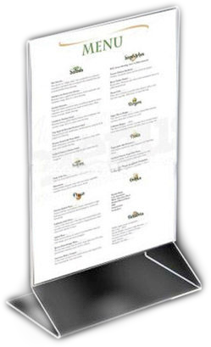
“Our request has to be transmitted to where
the drinks/data are stored.
Instructions are then issued based on our request.”

Slide 29

“If things run smoothly, the result of our request
eventually gets returned to us.”
“And, hopefully, everyone is happy!”

Slide 30
So Why Did You Choose PHP?
A defensive explanation into Using PHP as a Server Side Language
Notes:
The justification for using PHP

Slide 31
PHP is easy to learn
simple syntax
loosely typed
abundant amount of resources and large community
PHP makes up 80+% of all web sites
Thanks to WordPress, Joomla, and Drupal
PHP has an OK OOP implementation and it’s being improved in PHP 7
However many frameworks take care of this such as Laravel, CakePHP, Symfony, and CodeIgniter.
It’s great as a quick prototyping language to teach students the fundamentals of server side programming
Notes:
PHP is easy to learn:
it is a C based language which helps most programmers grasp the syntax quickly

